Slide 1
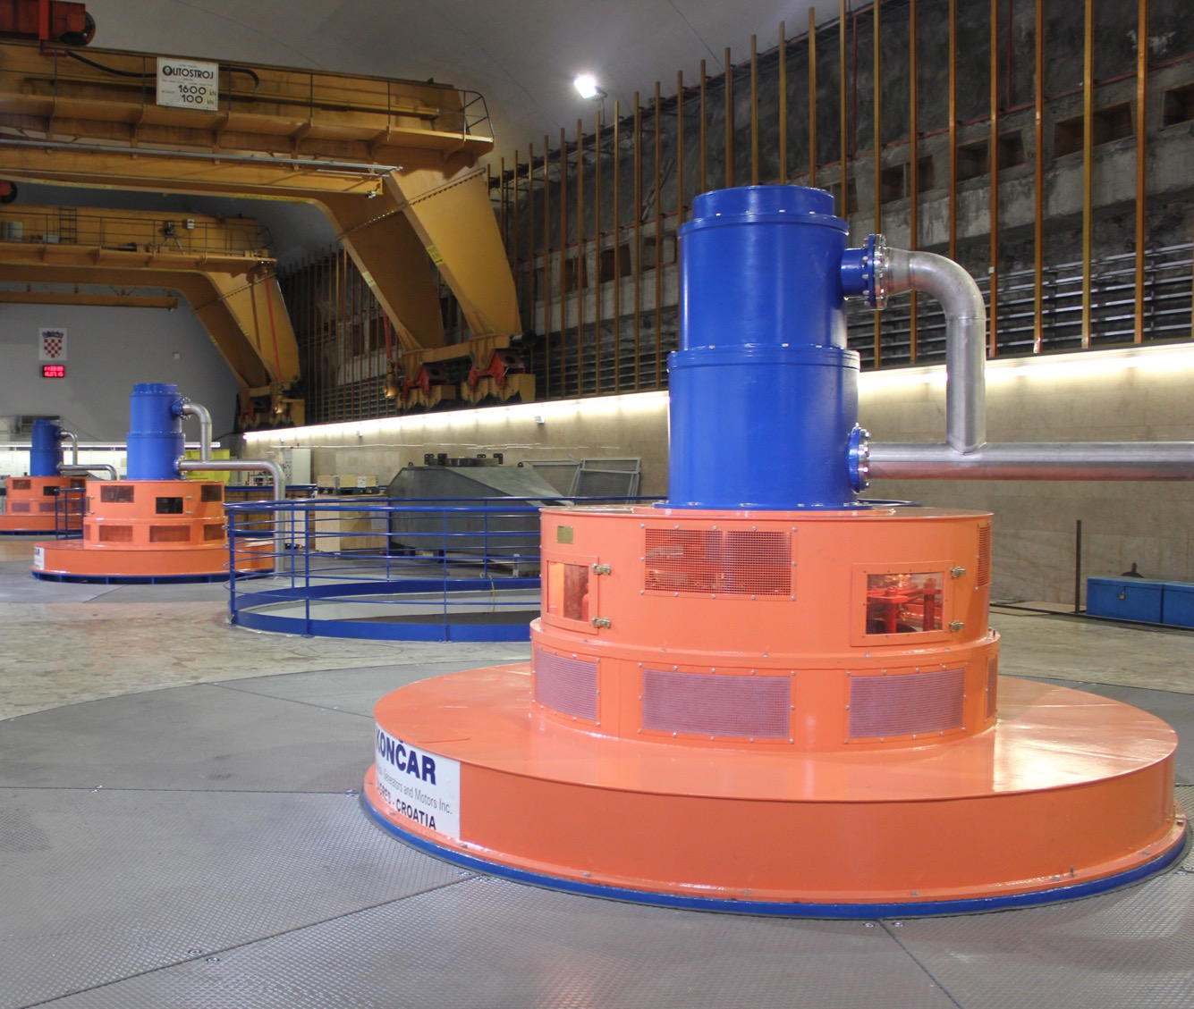
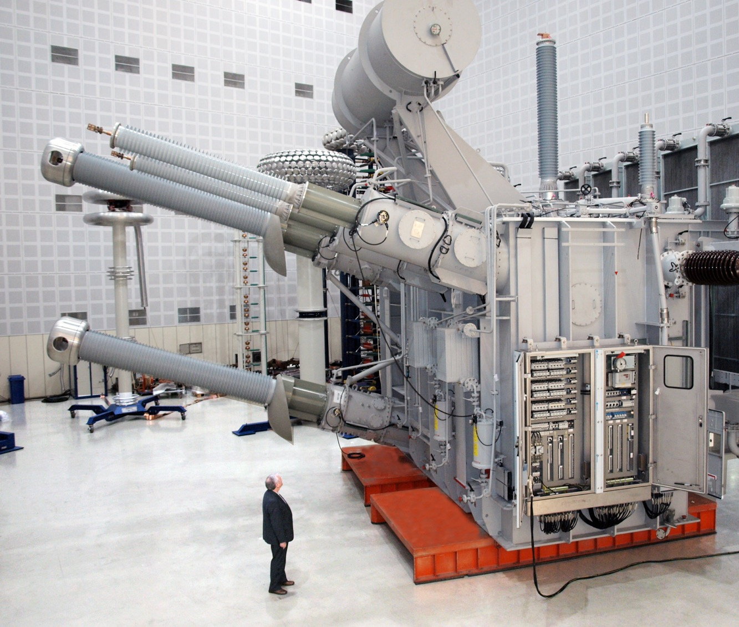
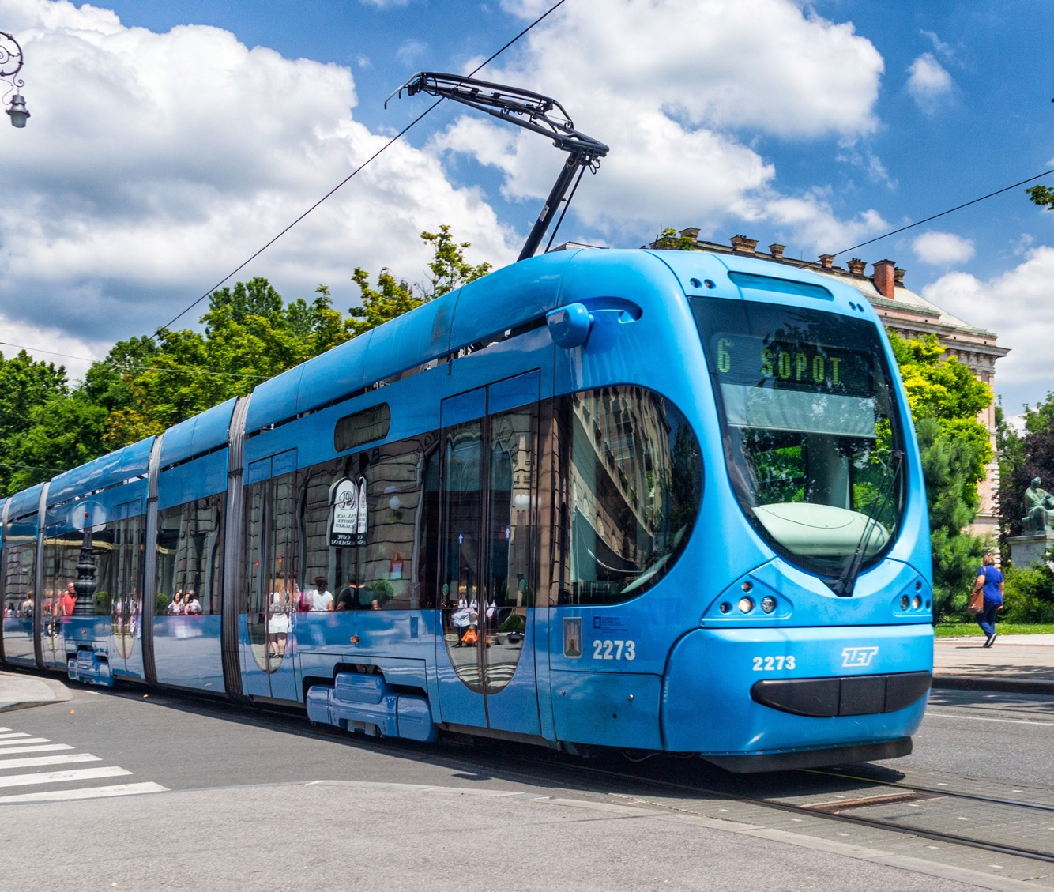
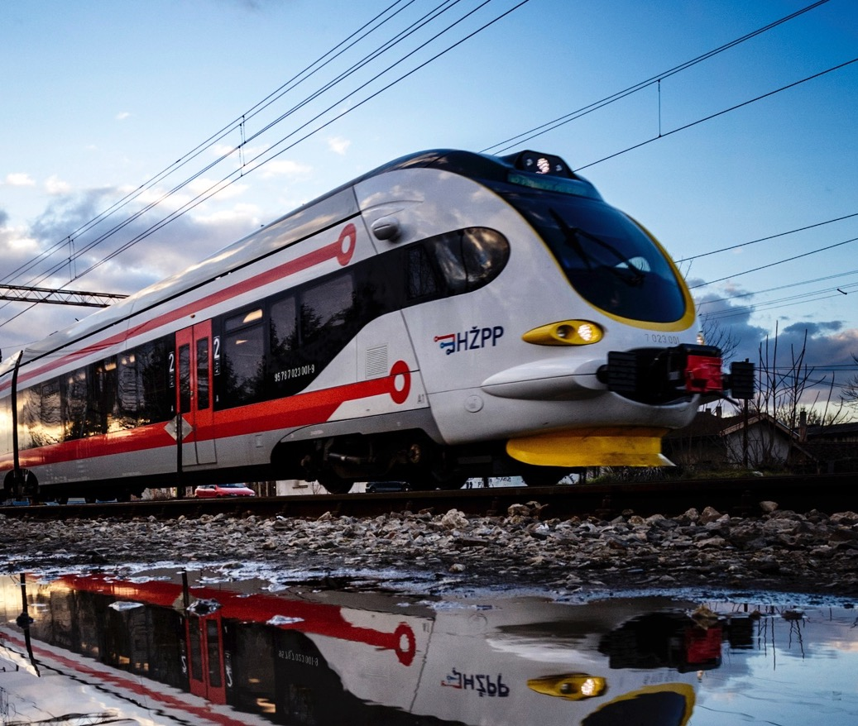
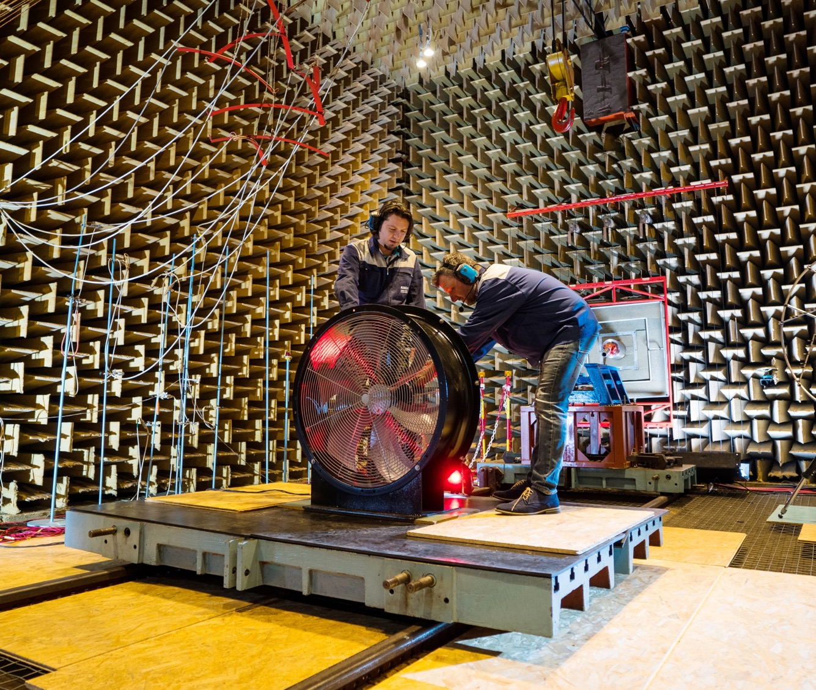
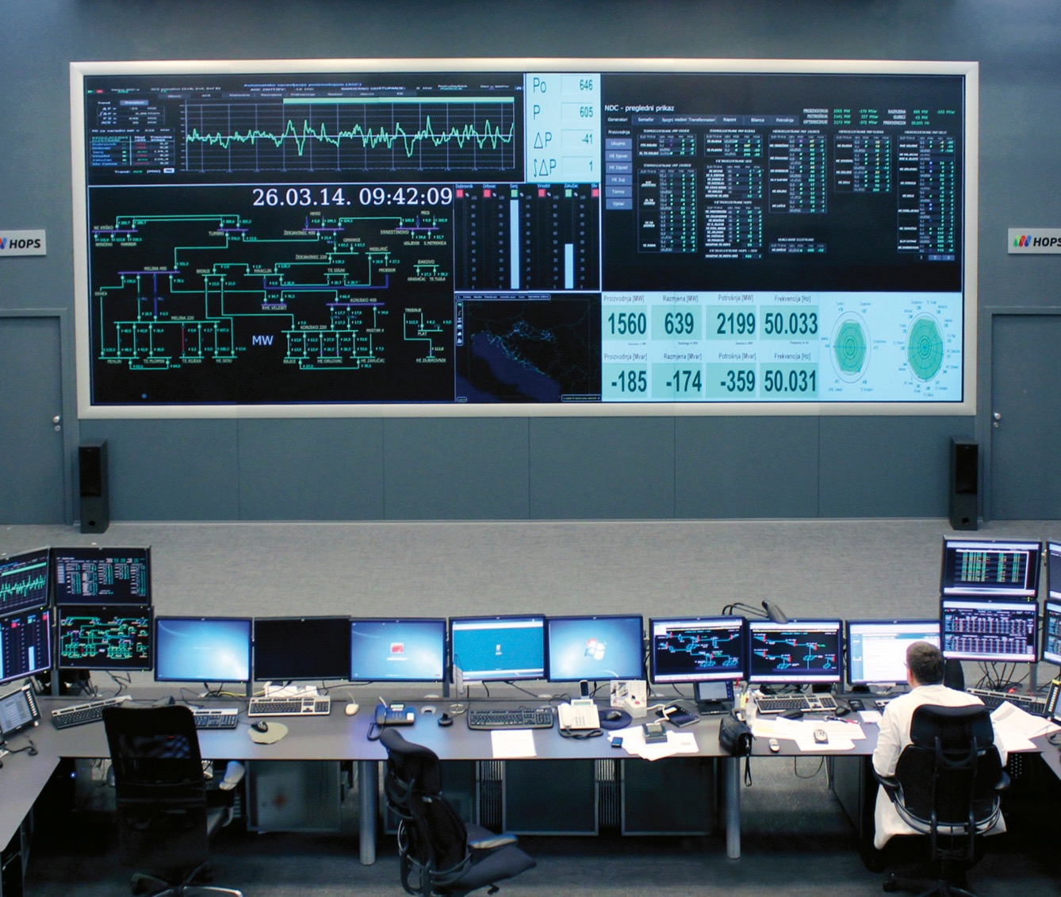
KONČAR GROUP
CENTURY OF EXCELLENCE AND
FORWARD LOOKING PERSPECTIVE

Slide 3
in a hundred years exported
YEAR OF ESTABLISHMENT: 1921
A century of experience through deliveries of facilities, solutions and equipment for markets worldwide
First generator manufactured in 1948 for HPP Mariborski Otok
First export in 1952, since then exported goods and services in excess of USD 6,4 billion
KONČAR GROUP OVERVIEW

Slide 4
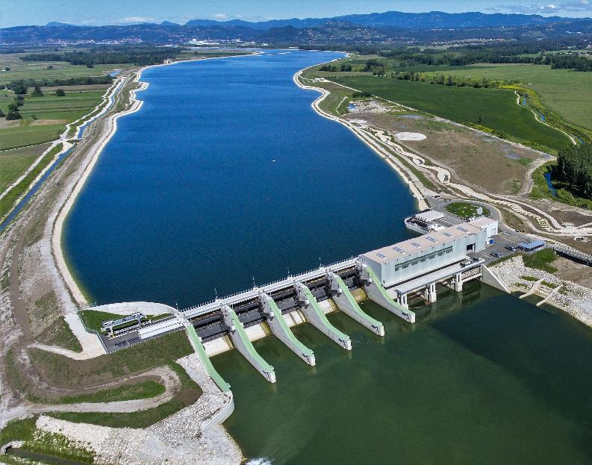
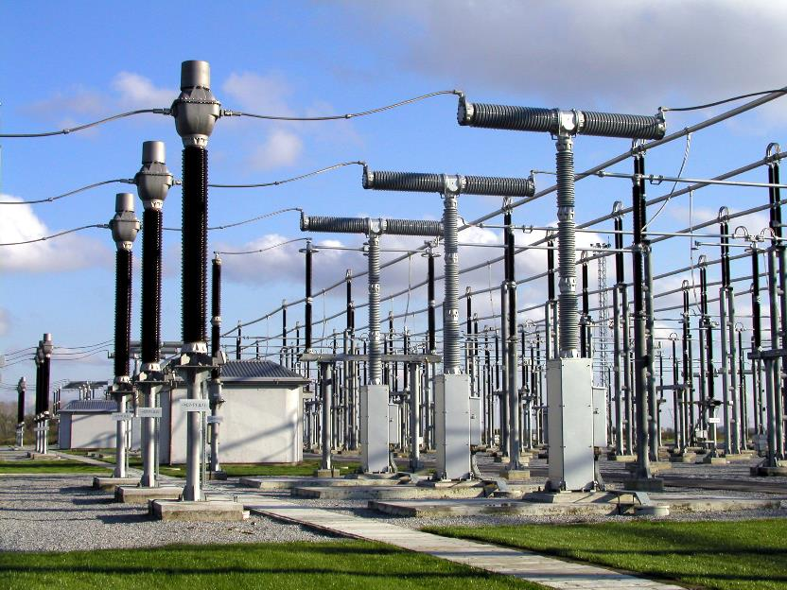
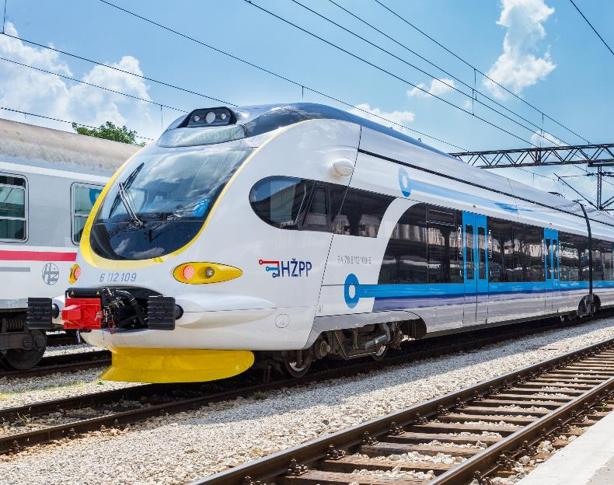
BUSINESS AREAS
Power generation
Power transmission and distribution
Rail solutions and infrastructure
Digital solutions and platforms
KONČAR GROUP OVERVIEW

Slide 5
HEADQUARTERS
Zagreb, Croatia
MAIN MARKETS
European Union
Asia and Africa
America and Australia
KONČAR GROUP OVERVIEW

Slide 6
RESULTS, JANUARY -SEPTEMBER 2021
REVENUES - EUR 334,4 million
EXPORT - 62%
ASSETS - EUR 570,9 million
PEOPLE - 3,500
KONČAR GROUP OVERVIEW

Slide 7
SHARES
Zagreb Stock Exchange, Croatia
2,572,119 ordinary shares
Market capitalization EUR 262,4 million (as of 15 November 2021)
KONČAR GROUP OVERVIEW

Slide 8
OWNERSHIP STRUCTURE AND MANAGEMENT
SUPERVISORY BOARD MEMBERS
Chairman: Joško Miliša
Deputy Chairman: Darko Horvatin
Members: Ivan Milčić, Branko Lampl, Danko Škare, Mario Radaković, Ruža Podborkić, Maja Martinović, Zvonimir Savić
AUDIT COMMITTEE
STRATEGIC DEVELOPMENT COMMITTEE
REMUNERATION COMMITTEE
NOMINATION COMMITTEE
Pension funds 50.2%
Croatian Pension Insurance Institue 28.2%
Republic of Croatia 2.6%
Tresaury shares 1%
Other shareholders 18%
Ownership structure as of 15 November 2021

Slide 9
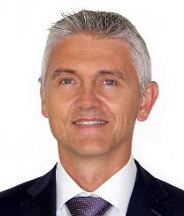
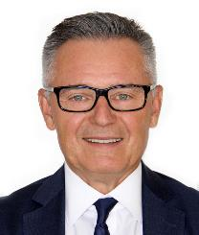
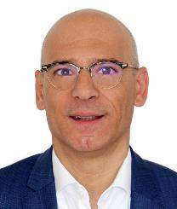
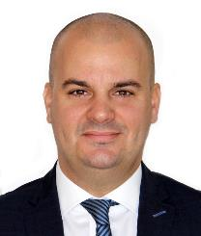
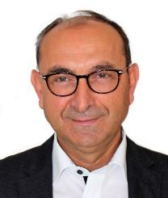
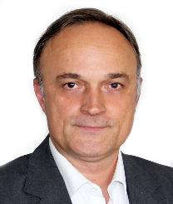
KONČAR GROUP MANAGEMENT
GORDAN
KOLAK
IVAN
BAHUN
Chairman of the
Management Board
Deputy Chairman of the
Management Board
MIKI
HULJIĆ
JOSIP
LASIĆ
JOSIP
LJULJ
BOŽIDAR
POLDRUGAČ
Member of the
Management Board
Member of the
Management Board
Member of the
Management Board
Member of the
Management Board

Slide 10
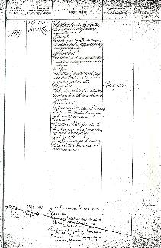
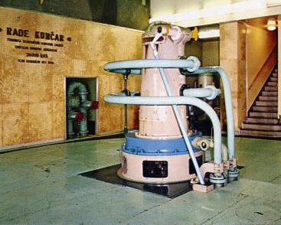
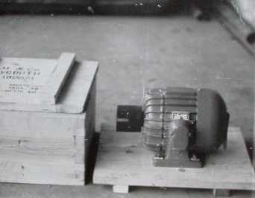
LONG TRADITION IN ELECTRICAL INDUSTRY
1921
1948
1952
On 24 January, the company ELEKTRA for electrotechnical and mechanical engineering industry registered
Serial production of transformers began
First deliveries of electric motors to Turkey paved the way to other foreign markets

Slide 11
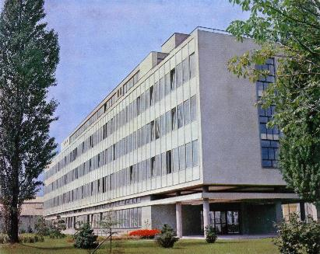
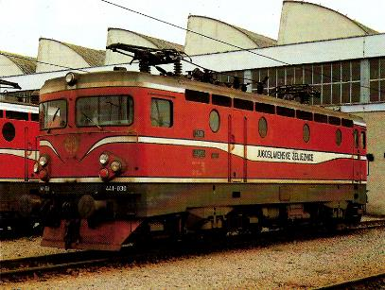
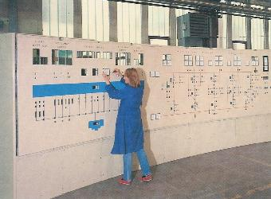
LONG TRADITION IN ELECTRICAL INDUSTRY
1961
1970
1987
Electrical Engineering Institute established with the aim of RDI and technological processes
First electric locomotive manufactured
HPP Haditha in Iraq commissioned

Slide 12
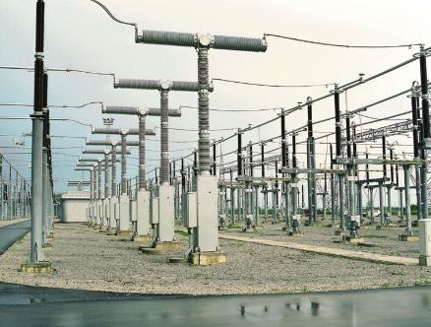
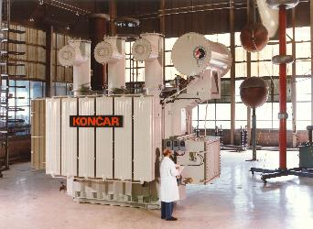
LONG TRADITION IN ELECTRICAL INDUSTRY
1993
2003
2005
First 30 MVA transformer manufactured
400/110 kV Ernestinovo substation refurbished
Low-floor tram
TMK 2200

Slide 13
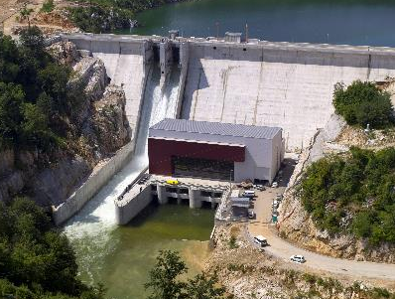
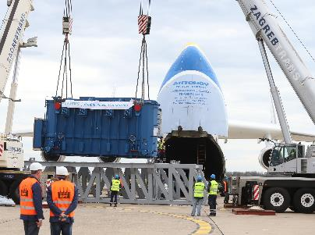
LONG TRADITION IN ELECTRICAL INDUSTRY
2010
2013
2016
HPP Lešće – first hydro power plant constructed in Croatia as an independent country
Transformer for HPP San Lorenzo weighing 140 tons transported onboard the world’s largest airplane
The first diesel-electric train developed and manufactured at KONČAR commissioned

Slide 14
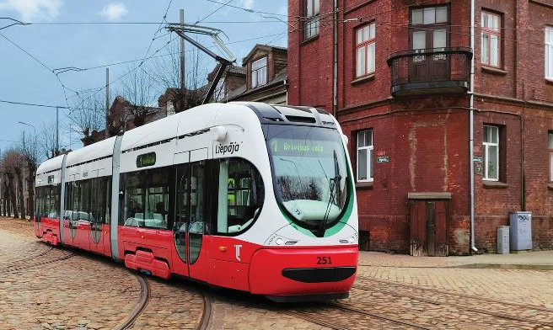
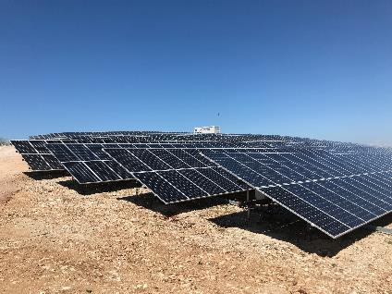
LONG TRADITION IN ELECTRICAL INDUSTRY
2020
2020
SPP Vis, at that time the largest solar power plant in Croatia, commisioned
The first low-floor tram for Latvia delivered

Slide 15
RECENT PROJECTS AND CONTRACTS OF GREAT IMPORTANCE FOR THE GROUP
Commissioning of the largest solar power plant in Croatia, SPP Vis; key elements of the power plant developed and manufactured at KONČAR
Step forward in the product range of KONČAR – Instrument Transformers through delivery of transformers for substation self supply, with voltage level of 525 kV and power output of 250 kVA, installed in the USA

Slide 16
RECENT PROJECTS AND CONTRACTS OF GREAT IMPORTANCE FOR THE GROUP
Delivery of first tram to Latvia and new contracts for another 8 (14 in total) trams for Latvian customer (total contract value EUR 21 million)
Contract with HŽ Passenger Transport for the purchase of 21 trains (contract value EUR 112,6 million)

Slide 17
RECENT PROJECTS AND CONTRACTS OF GREAT IMPORTANCE FOR THE GROUP
400/110 kV Ohrid substation
works kick off
Contract for reconstruction of
130 kV facility at a substation
in Sweden
Contract for 110/20 kV Rimac Campus substation

Slide 18
PEOPLE – AT THE FOREFRONT OF DEVELOPMENT AND FURTHER COMPANY TRANSFORMATION
LIFELONG LEARNING
Lifelong learning, professional development and fostering creativity represent the basis of KONČAR’s longevity and success
CREATING A POOL OF EXPERTS
Attracting talent and improving the perception of KONČAR Group as an employer of choice
Electrical engineers 45%
Mechanical engineers 23%
Economics 15%
Other 15%
Law 2%
A STEP FORWARD IN DIGITIZATION
A step forward in digitization plays an important role in attracting young engineers, more inclined to digital technologies
Out of 3,500 total employees,
42% hold university degrees

Slide 19
BUSINESS OPERATIONS
Q1–Q3 2020/2021
DOUBLE-DIGIT GROWTH
OF ALL KEY INDICATORS

Slide 20
Order intake
Operating income
+51.1%
+18.5%
DOUBLE-DIGIT GROWTH RATES OF ALL KEY PERFORMANCE INDICATORS
Backlog
EBITDA
+22.4%
+91.3%
EBITDA margin
Export sales
+360bps
+11.1%
Compared to the same period of 2020,
Backlog compared to 31 December 2020

Slide 21
GROWTH DRIVEN BY TRANSFORMER
AND RAIL SOLUTIONS SEGMENTS
 | Q1-Q3 2021 | Trend Q1-Q3 2021 vs 2020
Consolidated sales revenue | EUR 321,7 million | + EUR 48,3 million
Export sales | EUR 199,3 million | + EUR 19,9 million
Backlog | EUR 693,0 million | + EUR 126,6 million
Transformer program Stable profitability/significant increase in prices of main raw materials | EUR 155,4 million | + EUR 21,9 million
Rail solutions Delivery of trams to Liepaja and trains for HŽ Passenger Transport | EUR 37,8 million | + EUR 26,6 million

Slide 22
STOCK PRICE OUTPERFORMANCE
KOEI-R-A VS CROBEX
KOEI
CROBEX

Slide 23
FURTHER GROWTH OF ORDER INTAKE IN Q3
ORDER
INTAKE
EUR million
Q1-Q3 2020
Q1-Q3 2021
Book-to-bill ratio
1.39
SALES
REVENUE
EUR million
Q1-Q3 2020
Q1-Q3 2021

Slide 24
EBITDA AND EBITDA MARGIN
EBITDA
EBITDA MARGIN
EUR million
Q1-Q3 2020
Q1-Q3 2021
Q1-Q3 2020
Q1-Q3 2021
EBITDA NORMALIZED
NORMALIZED EBITDA MARGIN
EUR million
Q1-Q3 2020
Q1-Q3 2021
Q1-Q3 2020
Q1-Q3 2021
Notes:
Normalized EBITDA: EBITDA less the net effect of provisioning, asset sales revenue and loss compensation revenue, increased by value adjustment of current assets

Slide 25
REVENUE GROWTH IN MOST OF THE BUSINESS SEGMENTS
in EUR million | Q1-Q3 2020 | Q1-Q3 2021 | ∆ | Index 2021/2020
Transformer program | 134 | 155 | 22 | 116%
Engineering | 60 | 53,3 | -7 | 89%
Rail solutions | 11,5 | 37,9 | 26 | 330%
Rotating machines | 26,8 | 34 | 7 | 127%
Industrial electronics and development | 12 | 11,3 | -1 | 94%
Other | 29,6 | 29,9 | 0 | 101%
Sales income | 274 | 322 | 48,2 | 118%
Q1-Q3 2021
Q1-Q3 2020
EUR million
Note: non-consolidated data
Transformer
program
Engineering
Rail
solutions
Rotating machines
Industrial electronics and development
Other

Slide 26
EBITDA ACCORDING TO PRODUCT RANGE
EBITDA Q1-Q3 2021
EBITDA Q1-Q3 2020
EBITDA margin Q1-Q3 2021
EBITDA margin Q1-Q3 2020
EBITDA in EUR million | EBITDA Q1-Q3 2020 | EBITDA margin Q1-Q3 2020 | EBITDA Q1-Q3 2021 | EBITDA margin Q1-Q3 2021
Transformer program | 10 | 7.8% | 15 | 9.4%
Engineering | 1,2 | 2.0% | 2,5 | 4.7%
Rail solutions | 1,3 | 11.6% | 2,5 | 6.7%
Rotating machines | 0,2 | 0.5% | 3,1 | 9.1%
Industrial electronics and development | 1,3 | 11.1% | 2,8 | 24.7%
Other | 2 | 6.8% | 1,5 | 5%
EUR million
Note: non-consolidated data
Transformer
program
Engineering
Rail
solutions
Rotating machines
Industrial electronics and development
Other

Slide 27
MARKETS

Slide 28
FURTHER GROWTH IN EXPORT MARKET
REVENUES
+31%
TOTAL + 11.1%
Export realized in the amount of EUR 199,3 million
Share of export in total sales revenue is 62%
Strong growth in the EU, EUR 36,5 million more
Export decrease in other markets slowed in comparison to 1H 2021
Q1-Q3 2021
Q1-Q3 2020
EUR million
-40.3%
-0.6%
-36.7%
-7.9%

Slide 29
EXPORT – FURTHER GROWTH IN THE EU AND MILD RECOVERY IN OTHER MARKETS
EU countries | EUR million | +31%
Germany | 39,3 | +82.1%
Sweden | 28,2 | +15.1%
Austria | 14,3 | 2%
Non-EU European countries | EUR million | -0.6%
Norway | 5,2 | +11.2%
UK | 3,4 | -5.3%
Switzerland | 2,3 | -24.1%
America and Australia | EUR million | -36.7%
USA | 2,2 | -66.7%
Australia | 1,9 | -15%
Canada | 1,6 | +47.9%
Asia and Africa | EUR million | -40.3%
UAE | 5,0 | -18%
Philippines | 1,6 | +25.4%
Malesia | 1,2 | n/p
Regional countries | EUR million | -7.9%
Bosnia and Herzegovina | 4,1 | +83.5%
North Macedonia | 1,4 | -42.7%
Serbia | 0,8 | +42.4%

Slide 30
MARKETS – BACKLOG 30 SEP 2021
Backlog is 22.4% higher compared to the start of the year
Domestic market backlog is 17.9% higher
Export backlog is 28.2% up
EUR million
EUR 126,6 million rise compared to the start of the year
Croatia
Export
31.12.2018
31.12.2019
31.12.2020
30.9.2021

Slide 31
MARKETS – BACKLOG AND ORDER INTAKE
ORDER INTAKE
EUROPEAN UNION: EUR 205,3 million
D&ST, GIM, KEV: Germany, Austria, Sweden, Finland
NON-EU EUR COUNTRIES: EUR 22,8 million
ASIA AND AFRICA: EUR 17,3 million
D&ST, GIM, KET: UAE, Japan
AMERICA AND AUSTRALIA: EUR 14,5 million
GIM, KET, MJT: USA, Australia
REGIONAL COUNTRIES: EUR 8,9 million
KET: BiH, Macedonia
BACKLOG
EUR 692,9 million
Domestic market EUR 377,1 million
Export EUR 315,8 million

Slide 32
ORDER INTAKE - EXPORTS
EUR million
EUR million
EU
Asia and Africa
America and Australia
Regional countries
Non-EU European countries
Q1-Q3 2020
Q1-Q3 2021

Slide 33
2020+ INTEGRATED STRATEGY OF THE GROUP

Slide 34
MISSION AND VISION
OUR NEW MISSION
Inspired by challenge, we develop modern solutions for the electrical industry; we contribute to local manufacturing and energy sustainability of the society.
NEW DIMENSION OF DEVELOPMENT
OUR NEW VISION
An innovative partner for advanced solutions on the path of green energy transition and mobility.

Slide 35
2024
STRATEGIC OBJECTIVES
COMPETENCE
PEOPLE:
400 new engineers
COMPETITIVNESS
INTERNAL PROCESSES:
HRK 400 million of investment in development and technology (cca. EUR 54 million)
4
BASIC OBJECTIVES
EXPORT
MARKET:
4 new capital markets
GROWTH
FINANCE:
HRK 4 billion of revenue (cca. EUR 535 million)

Slide 36
SIX LEVERS OF TRANSFORMATION
1
INNOVATION AND TECHNOLOGICAL MODERNIZATION
4
IMPROVEMENT OF HUMAN RESOURCE MANAGEMENT
2
DIGITAL EVOLUTION
5
OPERATIONAL MODEL RESTRUCTURING
3
6
ACQUISITIONS AND STRATEGIC PARTNERSHIPS
SALES STRENGTHENING

Slide 37
OPERATIONAL MODEL
KONČAR – Electrical Industry Inc.
PARENT COMPANY FOCUS
Focus on strategic and financial objectives of the Group
DIVISION FOCUS
Focus on development of key markets and delivery of complex solutions
Power transmission and distribution
Rail
solutions
and infrastructure
Digital solutions and platforms
Power generation
GROUP MEMBERS FOCUS
Focus on development, manufacturing and sales of propriatery products and services

Slide 38
A LOOK AHEAD

Slide 39
INCREASE IN ORDER INTAKE AND SALES
ORDER
INTAKE
EUR million
2019
2020
Plan 2021
Book-to-bill ratio
2019 1.09
2020 1.26
2021 1.24
SALES
REVENUE
EUR million
2019
2020
Plan 2021

Slide 40
OVERVIEW OF 2021 AND FUTURE OBJECTIVES

Slide 41
AWARDS AND RECOGNITIONS
A century of excellence – KONČAR as the regional leader in electrical industry and rail solutions celebrates 100 years of operation; established as one of the largest Croatian exporters and one of the longest-living Croatian companies
According to Lider (business media) research, KONČAR is the largest Croatian net exporter of the decade; with nearly EUR 1,5 billion of ‘pure’ export generated
KONČAR – D&ST is the winner of the Golden Key award – best large exporter in 2020
KONČAR – KPT is the winner of the Golden Key award – best exporter to Qatar in 2020

Slide 42
BUSINESS PORTFOLIO CONSOLIDATION
KONČAR – Low Voltage Switches and Circuit Breakers acquired by KONČAR – Switchgear
KONČAR – Engineering for Plant Installation & Commissioning acquired by KONČAR – Power Plant and Electric Traction Engineering
KONČAR – Digital for digital services and solutions established
KONČAR – XD liquidated
Restructuring of joint stock companies wholly owned by the parent company into limited liability companies
M&A department set up
Project management office set up
Corporate controlling set up

Slide 43
YEAR-END OBJECTIVES
Revenue on track to achieve year-end targets, and further increase in order intake
Strong focus on order intake and expansion to new markets
Continued business optimization through cost control and the Group’s operational model change
M&A department – identification of potential target companies, access to new technologies, resources and talents
Investor relations – continuous improvements in investor relations, ensuring timely and accurate financial and non-financial information

Slide 44
LONG-TERM OBJECTIVES
The Management Board, appointed at the beginning of 2020, created the Integrated Strategy of the Group and defined the strategic priorities for the next period
Strategic priorities are focused on the development and innovation potential of the Group, key manufacturing capacities, their modernization and further strengthening of synergy at the Group level
In the next period, KONČAR Group sees great potential in renewable energy sources and additional decrease of harmful impact on the environment; taking a step forward in digitization of existing products and services and manufacturing capacities

Slide 45
SUSTAINABLE DEVELOPMENT STRATEGY
KONČAR – Electrical Industry Inc. and all Group companies pursue sustainability strategy in their operations.
Transition to a clean circular economy and active participation in responding to climate change, constitute an integral part of the vision and strategy of KONČAR as a socially responsible company.
Transformation of operations and implementation of sustainable production and consumption policies are in our focus.
We are dedicated to reducing consumption of natural resources, reducing production of hazardous and toxic substances, lowering emissions of harmful substances into the environment, and reducing and preventing waste generation.
All Group companies follow market trends and develop higher-efficiency products with ecological design (rail vehicles, transformer program, switchgear and control gear assemblies from which greenhouse gases are removed and dry air is introduced).

Slide 46
POTENTIAL CAPITAL INCREASE OF DALEKOVOD D.D.
Through the joint conditional bid of Construction Line and KONČAR – Electrical Industry, interest was expressed in financial restructuring of Dalekovod through investment in the company’s share capital.
Pursuant to the Public Call for investors to subscribe new shares in the second round, the company Advanced Energy Solutions Ltd. submitted an application for subscription of 31,000,000 new ordinary shares, which corresponds to the sum of capital injection of HRK 310,000,000.00 as a cash contribution (cca. EUR 41,3 million).
The founders of Advanced Energy Solutions from Zagreb are Construction Line Limited and KONČAR – Investments Ltd.
KONČAR – Investments Ltd. is wholly owned by KONČAR – Electrical Industry Inc.
On 28 September 2021, the Croatian Competition Agency delivered confirmation that the reported concentration, in accordance with Article 22(1) of the Competition Act, is deemed to be permitted on level 1.
The Commission for the protection of competition of the Republic of North Macedonia confirmed on 21 October 2021 that the concentration will not result in any significant prevention, limitation or distortion of effective competition on the market or an essential part of the market, all in accordance with the provisions of the Competition Act, within the meaning of Article 19(1)(2).

Slide 47
THANK YOU FOR YOUR ATTENTION!
Investor relations
ir@koncar.hr

